Slide 1
MPEG-21: The 21st Century Multimedia Framework
Jan Bormans, Jean Gelissen, and Andrew Perkis
IEEE Signal Processing Magazine,
March 2003

Slide 2
Outline
Context and motivation of MPEG-21
An overview of MPEG-21 specifications
UMA and MPEG-21

Slide 3



Multimedia Technology
Multimedia technology provides content creators and consumers with a myriad of coding, access, and distribution possibilities.
Individuals are producing more and more digital media for both professional and personal use.
Content creators and consumers
More and more digital media are created

Slide 4




Content Access and Delivery
Communication infrastructure is being put into place to enable access to information and multimedia services from anywhere at anytime.
Existing business models for trading physical goods must be extended and new models for distributing and trading digital contents electronically are required.
Communicating everywhere at anytime
Traditional and new business models

Slide 5
Problems of Multimedia
No end-to-end solutions exist that allow different user communities to interact in an interoperable and standardized way, thus stalling the deployment of advanced multimedia packaging and distribution applications
Users are not given tools to deal efficiently with the intricacies of this new multimedia usage context

Slide 6
MPEG-21
In 2002 June, MPEG (ISO/IEC JTC1 SC29 WG11) started working on the definition of enabling normative technology for the multimedia applications of the 21st century: MPEG-21 “Multimedia Framework”
  To enable transparent and augmented use of multimedia resources across a wide range of networks and devices
  To support transparent and highly automated transactions, especially taking in account
    Digital rights management (DRM) requirements
    Multimedia access and delivery using heterogeneous networks and terminals

Slide 7
Digital Rights Management
The desire to achieve interoperability may be in violation with the requirement to protect the value of the content and the rights of the rights holders
  DRM systems can go against the very goal of interoperability if they use non-standardized protection mechanism
  To realize an open multimedia infrastructure, more interoperability in DRM systems are crucial
IPMP in MPEG series
  MPEG-4 describes a set of standard interfaces to proprietary intellectual property management and protection (IPMP) systems
  IPMP is at the very core of the MPEG-21 specifications

Slide 8







Heterogeneous Terminals and Networks
Terminals with different computation and rendering capability
The heterogeneous terminals and networks makes it difficult for content creators and service providers to ensure that their content can be used and rendered in a meaningful way
Networks with differing bandwidth and characteristics

Slide 9



Different Points of Views
Content accessing and creating should be offered services with
an a priori known subjective quality at a known/agreed price
Network and terminal installation/management/implementation
issues should be shielded
“high-level” user parameters, subjective quality and price, need
to be mapped transparently to the underlying network and
terminal parameters
User
Application serving the user should be able to translate the user
requirements into a network “QoS” contract
The contract is handled between the user and the network and
guarantees the delivery of a given QoS network service
The contract is likely to have a dynamic nature
Network
The impact on the end-user perception of the variation in
resource requirements associated to accessing dynamic,
heterogeneous content should be kept hidden or minimum
The terminal should allow for trade-offs between the resource
budgets and the end-user’s perception
Terminal
Media Scalability in MPEG-4

Slide 10
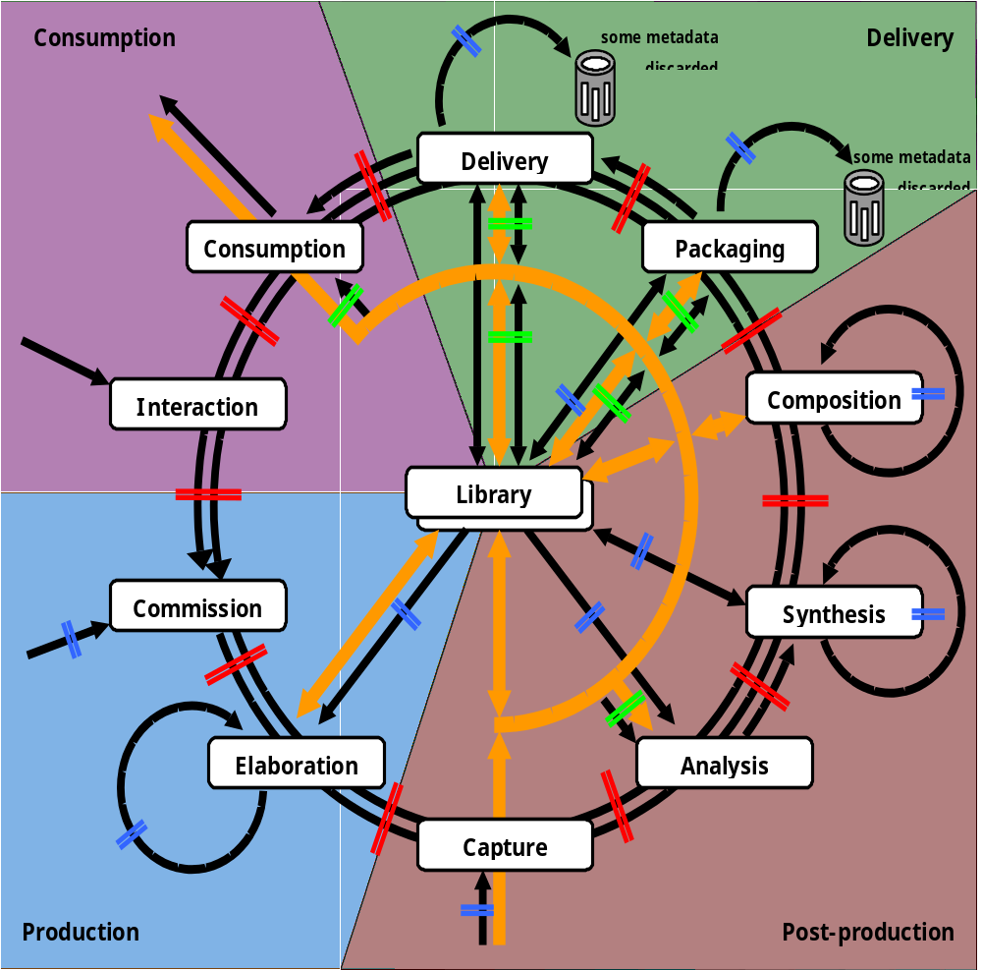
MPEG-21 Vision
MPEG-21 aims at defining a normative open framework
  For multimedia delivery and consumption for use by all the players in the delivery and consumption chain
  To enable transparent and augmented use of multimedia resource across a wide range of networks and devices used by different communities

Slide 11
Current Status of MPEG-21
Part |  | Current Status
1 | Vision, Technology and Strategies | TR
2 | Digital Item Declaration (DID) | FDIS
3 | Digital Item Identification and Description (DII) | FDIS
4 | Intellectual Property Management and Protection (IPMP) | CD
5 | Rights Expression Language (REL) | FCD
6 | Rights Data Dictionary (RDD) | FCD
7 | Digital Item Adaptation (DIA) | CD
8 | Reference Software | SW
9 | File Format | WD
10 | Digital Item Processing (DIP) | WD
11 | Evaluation Methods for Persistent Association Technologies | Request
12 | Test Bed for MPEG-21 Resource Delivery | WD

Slide 12
Two Essential Concepts of MPEG-21
Digital Item (DI)
  “What” of the multimedia framework
User (U)
  “Who” of the multimedia framework
Goal of MPEG-21
  Defining the technology needed to support users to exchange, access, consume, trade, and otherwise manipulate digital items in an efficient, transparent, and interoperable way.

Slide 13
Digital Items
Digital Items
  A structured digital object with a standard representation, identification, and associated metadata within the MPEG-21 framework
  The fundamental unit of distribution and transaction within the MPEG-21 framework
  MPEG-21 defines a set of abstract terms and concepts to form a useful model for defining DI in DID
    Digital representation of some work
    The unit that is acted upon

Slide 14
Users
Users
  Any entity that interacts within the MPEG-21 environment or makes use of DI
  Including individuals, consumers, communities, organizations, corporations, consortia, and governments
  A content provider and a consumer are both users.
  A user may assume specific or unique rights and responsibilities according to their interaction with other users within the framework
User A
User B
Transaction/Use/Relationship
⬅Digital Item➔
⬅Authorization/Value Exchange➔
Users are identified specifically by their relationship to another User for a certain interaction

Slide 15
Interactions between U and DI
What is the structure of the
fundamental unit of distribution
and transaction?
Examples:
Container
Item
Digital Item
Declaration
Examples:
Unique identifiers
Content Description
Digital Item
Identification and
Description
What content actually has been
delivered?
Examples:
Storage Management
Content Personalization
How is the content used
and delivered?
Content Handling
And Usage
User A
User B
Transaction/Use/Relationship
⬅Digital Item➔
⬅Authorization/Value Exchange➔
Intellectual Property
Management and
Protection
How are rights controlled in
respect of each User?
Is the content delivered
over a cable line or cell phone?
Examples:
Resource Abstraction
Resource Mgt. (QoS)
Terminals and
Networks
Examples:
Usage Permissions
Authentication
Is it natural or synthetic content?
How does it scale?
Content
Representation
Examples:
Error Resilience
Scalability
What reportable event has
happened and how is it described?
Event Reporting
Event Reporting provides metrics and interfaces for other six key elements

Slide 16
Part 1: Vision, Technologies, and Strategy
Fundamental purpose of this technical report
  Define a vision for multimedia framework to enable transparent and augmented use of multimedia resource across a wide range of networks and devices to meet the needs of all users
  Achieve the integration of components and standards to facilitate harmonization of technologies for the creation, management, transport, manipulation, distribution, and consumption of DIs.
  Define a strategy for achieving a multimedia framework by the development of specifications and standards based on well-defined functional requirements through collaboration with other bodies

Slide 17
Part 2: Digital Item Declaration
There are many kinds of content and probably just as many possible ways of describing it to reflect its context of use.
A powerful and flexible model for DIs must be able to
  Accommodate the myriad forms content can take now and in the future
  Used to represent any DI unambiguously
  Used to communicate DIs successfully

Slide 18

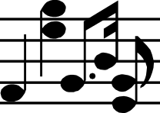
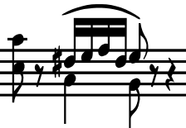
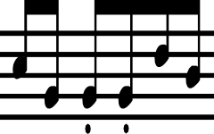







Part 2: Digital Item Declaration (cont.)
Two Examples of DI comprising a series of media resources
MPEG-21 Music Album
Web Page
HTML file
Elephant
Go!!Go!!
…
Links
Scripts
Audio files (Track)
Text file
(Lyrics)
Image
(Cover)
Text file
(Introduction)
Image
(Artwork)
Image
(GIF)
Image
(JPEG)
Video
?

Slide 19
Part 2: Digital Item Declaration (cont.)
Relationships between the resources and how they relate to the DI itself is defined in the DID
DID is a document that specifies the makeup, structure, and organization of DI
  Three normative clauses
    Model
      Abstract terms and concepts to form a model for defining DIs
    Representation
      Description of the syntax and semantics of each DI declaration elements ( represented in XML)
    Schema
      The XML schema comprising the entire grammar of the DID representation

Slide 20
Part 3: Digital Item Identification and Description
Besides references to the resources, the DID can contain information about the item itself and consisting parts.
Current situation
  Proprietary identifying and description systems co-exist with standardized schemes
  Some identifiers have been successfully implemented and commonly used, but they are specific to individual media types
  The majority of content lacks identification and description.
  There is no mechanism to ensure the identity and description information is persistently associated with the content
    Through file headers
    Through digital watermarking

Slide 21
Part 3: Digital Item Identification and Description (cont.)
  DII provides a normative way to express how the identification can be expressed and associated with DIs, containers, components, and fragments by including them in a specific place in the ID
    DI and resources are identified by encapsulating Uniform Resource Identifier (URI) into the identifier element
    Likely identifiers include descriptive, control, revision tracking and identifying info.

Slide 22
Interoperability in DRM
IPMP in MPEG-4
  Hooks
    A set of standard interfaces to proprietary IPMP systems, deeply embedded in MPEG-4 systems
    If you want to play some content, you only need to plug in the right IPMP system, and where to obtain it can be signaled in the bitstream
  Interoperability loss
    E.g. a portable music player cannot download a IPMP system
Interoperability in DRM
  A very difficult problem since standardized trust is needed
  E.g. content owners must trust all the players that consume contents

Slide 23
Part 4: Intellectual Property Management and Protection
MPEG-21 part 4 defines an interoperable framework for IPMP, built further on IPMP work in MPEG-4, including
  Standardized ways of
    Retrieving IPMP tools from remote locations
    Exchanging messages between IPMP tools
    Exchanging messages between IPMP tools and terminals
  Authentication of IPMP tools
  Integrating rights expressions according to REL and RDD

Slide 24
Part 5: Rights Expression Language
MPEG-21 Part 4: Rights Expression Language is a machine-interpretable language intended to provide mechanisms to support use of digital content in a way that protects digital content and honors the rights, conditions, and fees specified for digital contents.
It also supports specification of access and use controls and exchange of private or sensitive digital content

Slide 25
Part 6: Rights Data Dictionary
A dictionary of key terms required to describe rights of those who control DIs, including intellectual property rights and the permission they grants.
Part 5 and Part 6 together allow the expression of rights in an interchangeable form using a standardized syntax (REL) and standardized terms (RDD).

Slide 26

Universal Multimedia Access
Mobile Phone
(3G terminals)
UMA deals with the delivery of media resources under different network conditions, User preferences, and capabilities of terminal devices.
Wired and wireless systems can access the same media resource provider and receive media resources enabled for their system capability
UMA will be a driving force behind the development of services in 3G systems
Broadcast
UMA Network
Desktop
Media Resource
Provider
PDA
Laptop
The UMA concept

Slide 27
Part 7: Digital Item Adaptation
Digital Item
Adaptation Engine
Resource
Adaptation Engine
Adapted
Digital Item
Digital Item
Description
Adaptation Engine
Adaptation engines are non-normative
Descriptions and format-independent mechanisms are normative
DIA Tools
DIs are subject to a resource adaptation engine, as well as a descriptor adaptation engine,
which together produce the adapted DI

Slide 28




Part 7: Digital Item Adaptation (cont.)
Requirements on Usage Environment Description
Terminal capabilities
Network capabilities
User info.
Delay characteristics
Error characteristics
Bandwidth characteristics
User preferences
Demographic info.
Acquisition properties
Device type and profile
Output properties
H/W and S/W properties
System properties
IPMP capabilities
Natural Env.
Delivery capabilities
Location
Type of location
Available access
network
Velocity
Illumination
Supported transport
protocol types
Supported connection
types
Service capabilities
User roles
Type of service
Interactions and relations
Mechanisms
Taking usage environment changes into consideration
Dynamic updating of descriptions
Vocabularies

Slide 29
Part 7: Digital Item Adaptation (cont.)
Requirements on media resource adaptatibility
  Format descriptions independent of actual content representation formats
  Description of scalable content representation formats
  Descriptions that can be automatically extracted from the resource in a format-independent way
  Description of resources in terms of perceived quality and associated processing complexity
  Description of metadata in terms of perceived importance and associated processing complexity

Slide 30
Related Work
Mediacom 2004
  Established by ITU
  A framework for the harmonized and coordinated development of global multimedia communication standards
Capacity-exchange related standards
  W3C
    HTTP 1.1’s content negotiating
    Composite Capability/ Preferences Profile (CC/PP) for terminal to adapt content
  Web Forum
  IETF
  ISO
DVB-MHP

Slide 31
Conclusion
MPEG-21 offers exciting solutions to support interoperable exchanging, accessing, consuming, trading, and otherwise manipulating DIs between Users in an efficient, transparent, and interoperable way
MPEG-21 provides DI Adaptation to enable UMA scenarios.

